Slide 1

Bioinformatics Bootcamp
Special Topic Workshop: “Single Cell RNA-Seq Analysis”
Module 1: Orientation, Intro to scRNA-Seq, and Loading scRNA-Seq Data

Slide 2
Workshop Orientation

Slide 3
Why a workshop?
Those who know bioinformatics will be…

Slide 4
Why a workshop?
Those who know bioinformatics will be…
More effective at research

Slide 5
Why a workshop?
Those who know bioinformatics will be…
More effective at research
More competitive for jobs/funding

Slide 6
Why a workshop?
Those who know bioinformatics will be…
More effective at research
More competitive for jobs/funding
More flexible/adaptable to changes in their field

Slide 7
Why a workshop?
Those who know bioinformatics will be…
More effective at research
More competitive for jobs/funding
More flexible/adaptable to changes in their field
But in this workshop, the point is to learn….

Slide 8
Single cell RNA-Sequencing

Slide 9
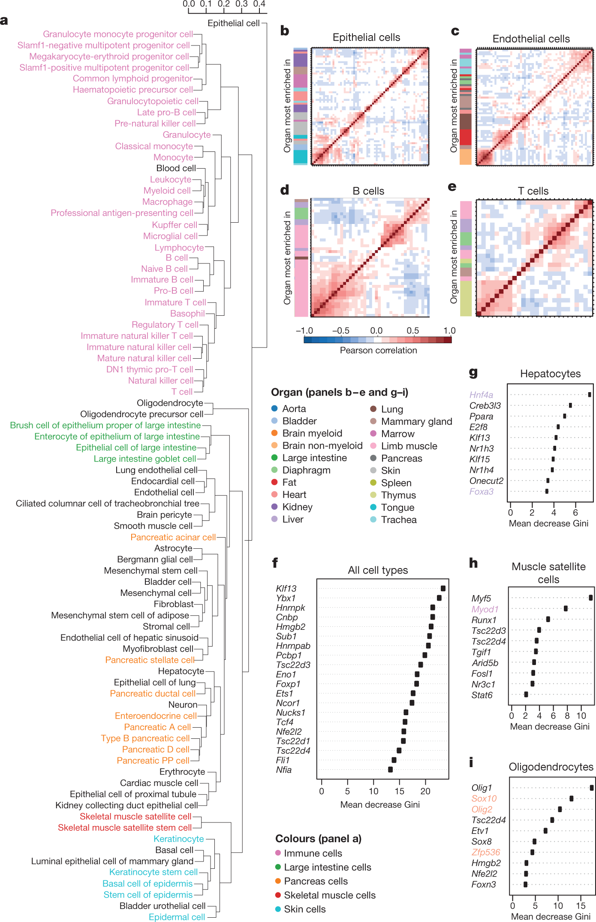
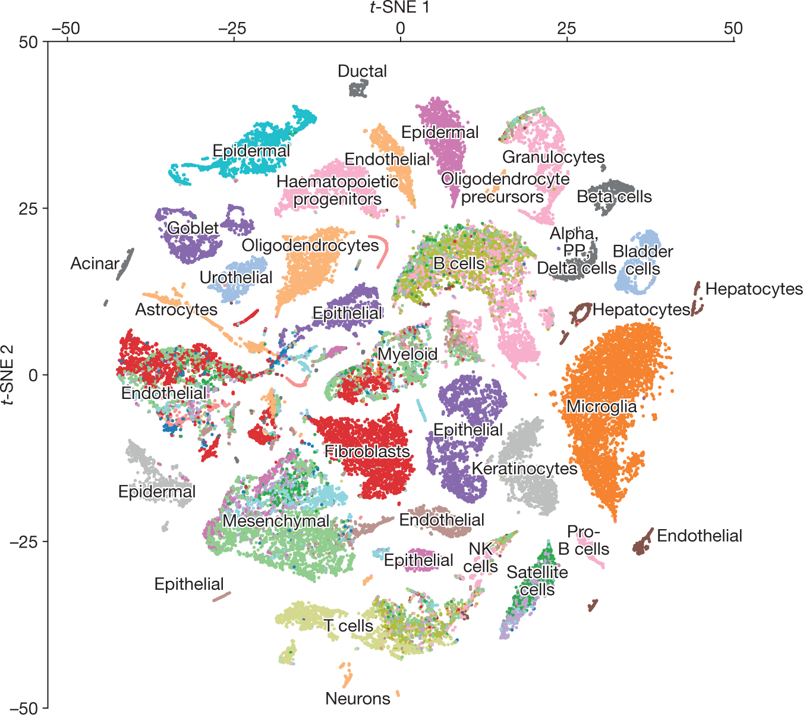
Single cell RNA-Sequencing
The Tabula Muris Consortium., Overall coordination., Schaum, N. et al. Single-cell transcriptomics of 20 mouse organs creates a Tabula Muris. Nature 562, 367–372 (2018). https://doi.org/10.1038/s41586-018-0590-4

Slide 10
Learning goals and objectives
From this workshop, you will learn how to:

Slide 11
Learning goals and objectives
From this workshop, you will learn how to:
Perform basic scRNA-Seq data preparation.

Slide 12
Learning goals and objectives
From this workshop, you will learn how to:
Perform basic scRNA-Seq data preparation.
Use manifold learning techniques to analyze cellular relationships in scRNA-Seq data.

Slide 13
Learning goals and objectives
From this workshop, you will learn how to:
Perform basic scRNA-Seq data preparation.
Use manifold learning techniques to analyze cellular relationships in scRNA-Seq data.
Find and interpret biologically-meaningful patterns in scRNA-Seq data.

Slide 14
Learning goals and objectives
From this workshop, you will learn how to:
Perform basic scRNA-Seq data preparation.
Use manifold learning techniques to analyze cellular relationships in scRNA-Seq data.
Find and interpret biologically-meaningful patterns in scRNA-Seq data.
Integrate single cell data from multiple batches, studies, or modalities.

Slide 15
Learning goals and objectives
From this workshop, you will learn how to:
Perform basic scRNA-Seq data preparation.
Use manifold learning techniques to analyze cellular relationships in scRNA-Seq data.
Find and interpret biologically-meaningful patterns in scRNA-Seq data.
Integrate single cell data from multiple batches, studies, or modalities.
Present the results of scRNA-Seq analyses with publication-quality figures.

Slide 16
Learning goals and objectives
From this workshop, you will learn how to:
Perform basic scRNA-Seq data preparation.
Use manifold learning techniques to analyze cellular relationships in scRNA-Seq data.
Find and interpret biologically-meaningful patterns in scRNA-Seq data.
Integrate single cell data from multiple batches, studies, or modalities.
Present the results of scRNA-Seq analyses with publication-quality figures.
By the end, you will gain the skills and confidence to use scRNA-Seq analysis in your research.

Slide 17
Single cell RNA-Sequencing
The Tabula Muris Consortium., Overall coordination., Schaum, N. et al. Single-cell transcriptomics of 20 mouse organs creates a Tabula Muris. Nature 562, 367–372 (2018). https://doi.org/10.1038/s41586-018-0590-4

Slide 18
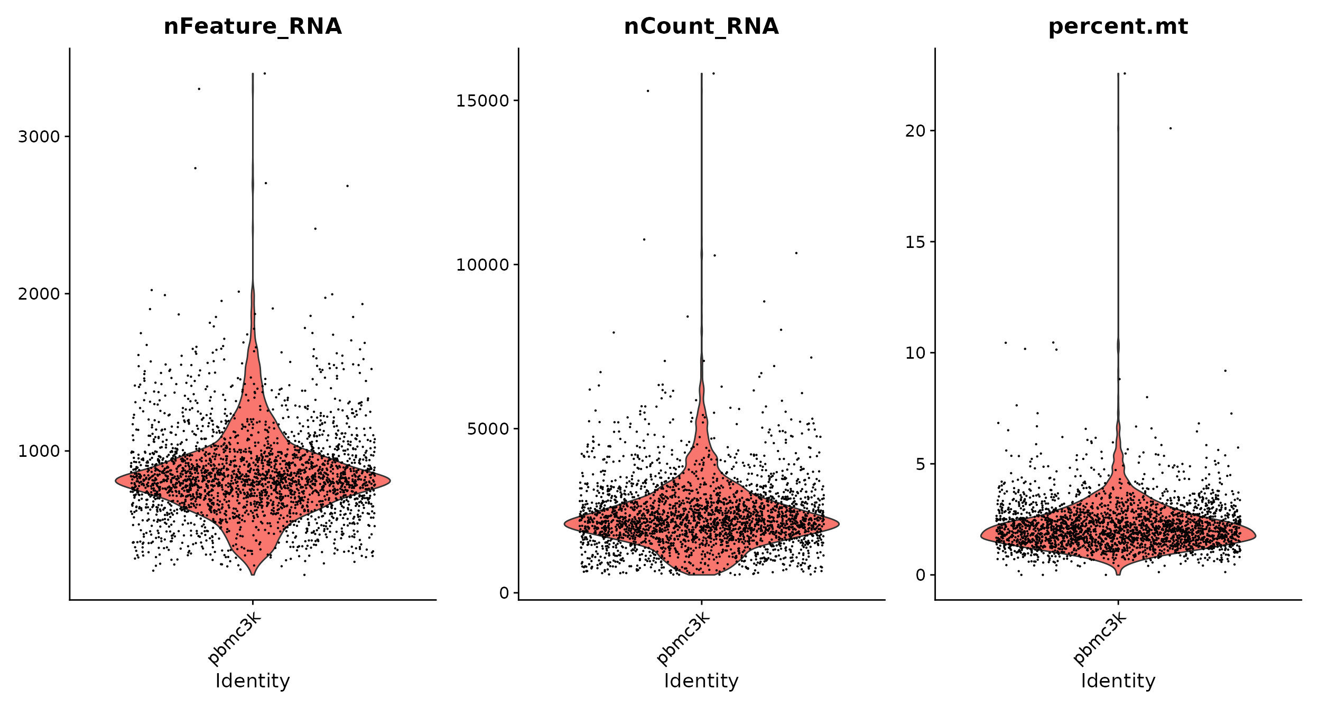
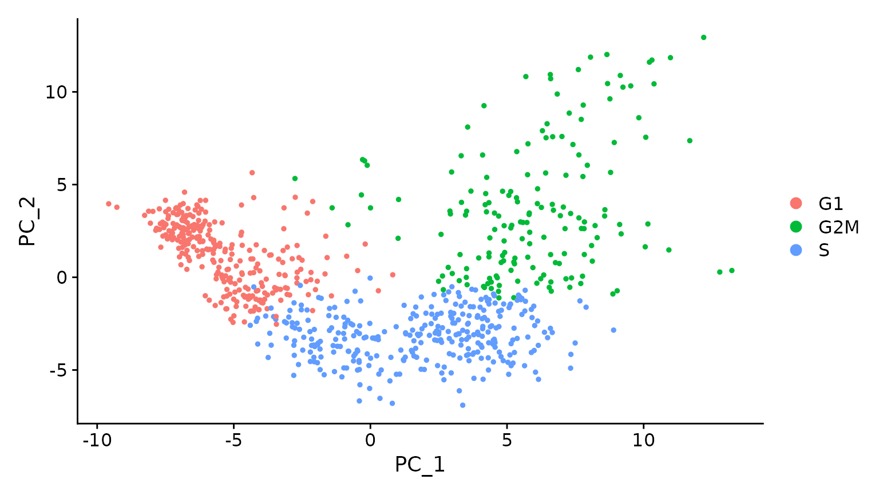
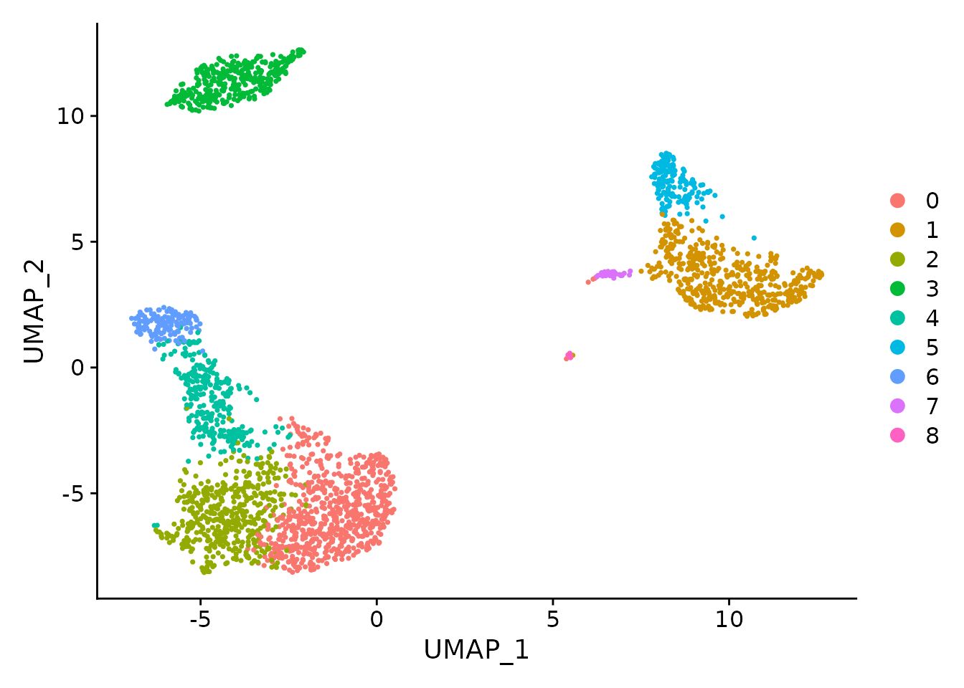
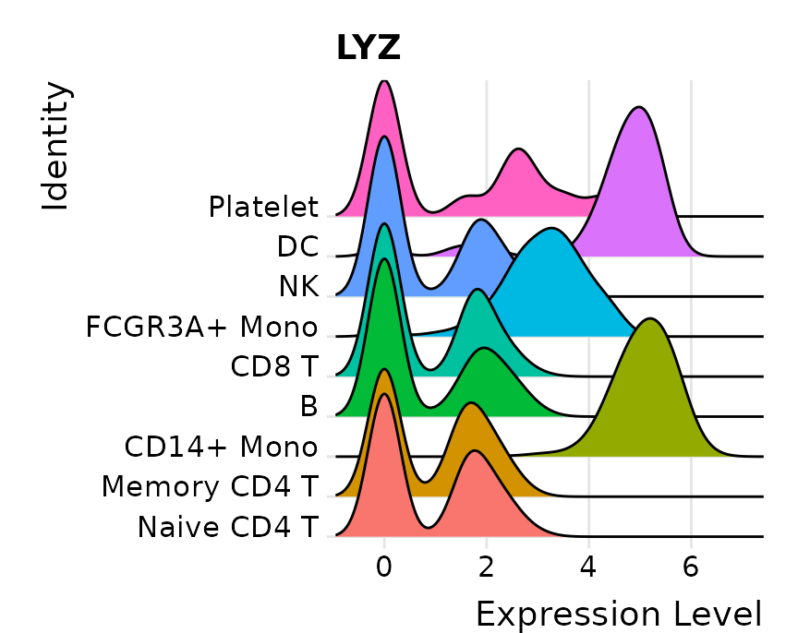
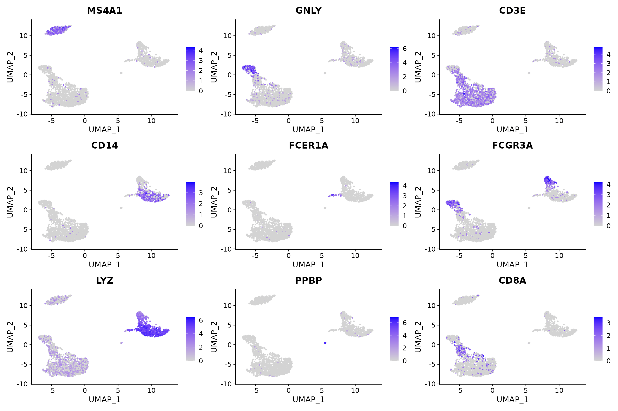
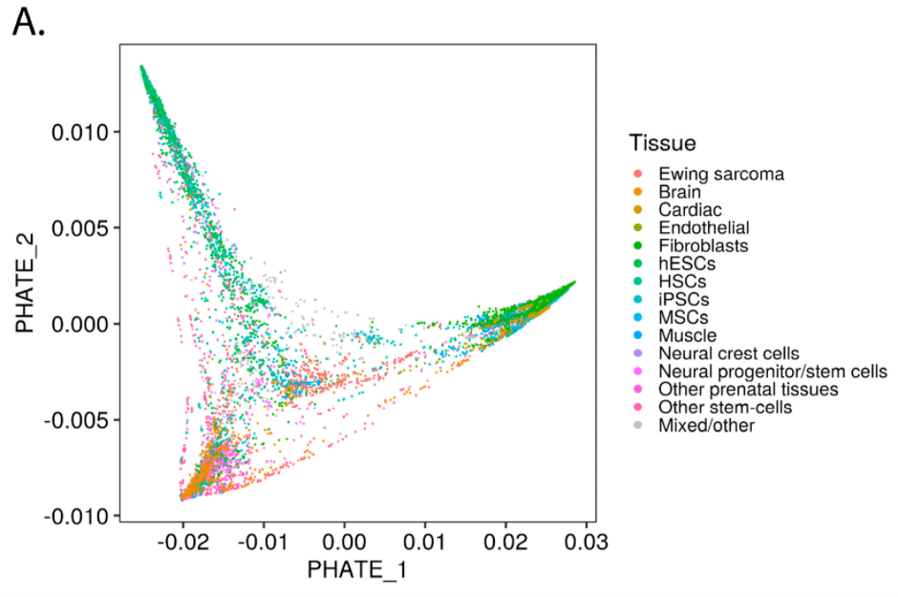
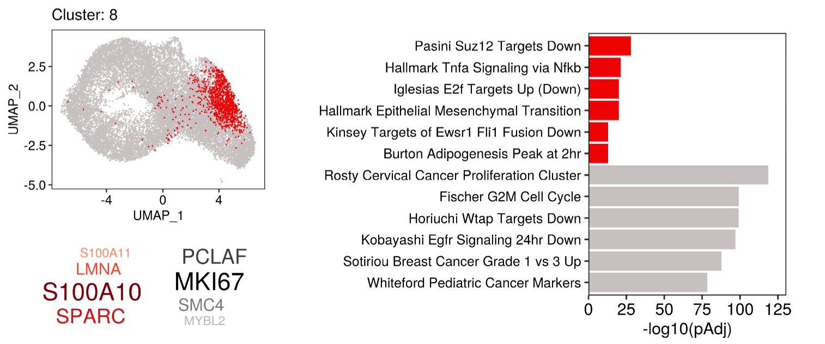
https://satijalab.org/seurat/articles/
Miller, H.E.; Gorthi, A.; Bassani, N.; Lawrence, L.A.; Iskra, B.S.; Bishop, A.J.R. Reconstruction of Ewing Sarcoma Developmental Context from Mass-Scale Transcriptomics Reveals Characteristics of EWSR1-FLI1 Permissibility. Cancers 2020, 12, 948. https://doi.org/10.3390/cancers12040948

Slide 19
Workshop Structure
Most sessions will be one hour of lecture and 30 minutes of hands-on activities.

Slide 20
Workshop Structure
Most sessions will be one hour of lecture and 30 minutes of hands-on activities.
***Lectures will be recorded***

Slide 21
Workshop Structure
Most sessions will be one hour of lecture and 30 minutes of hands-on activities.
***Lectures will be recorded***
Outline
Module 1: Orientation and Review of R/RNA-Seq analysis
Module 2: Prepping scRNA-Seq data for analysis
Module 3: Uncovering dataset structure with manifold learning
Module 4: scRNA-Seq biological interpretation
Module 5: Advanced topics in single cell analysis
Module 6: Final Project (finding tumor metastatic subpopulations)

Slide 22
How to succeed in this workshop
Respect the prerequisites.
Basic familiarity with R programming and RNA-Seq analysis
You can catch up on these concepts by reviewing Fall 2020 R Programming and RNA-Seq analysis BIG club workshop (link)

Slide 23
How to succeed in this workshop
Respect the prerequisites.
Basic familiarity with R programming and RNA-Seq analysis
You can catch up on these concepts by reviewing Fall 2020 R Programming and RNA-Seq analysis BIG club workshop (link)
Use DataCamp Classroom and pursue outside learning (e.g., codecademy, RStudio books, etc)

Slide 24
How to succeed in this workshop
Respect the prerequisites.
Basic familiarity with R programming and RNA-Seq analysis
You can catch up on these concepts by reviewing Fall 2020 R Programming and RNA-Seq analysis BIG club workshop (link)
Use DataCamp Classroom and pursue outside learning (e.g., codecademy, RStudio books, etc)
Communicate with your instructors
Email any time and attend Zoom office hours (listed in the syllabus)

Slide 25

About BIG club
Bioinformatics Interest Group (BIG) is a UT Health SA club promoting student engagement with bioinformatics.
Leadership
President: Muku Bhandari
Vice President: Victoria Alers
Secretary: Paul Ramirez
Training committee chair: Henry Miller
Historian: Aiola Stoja
Treasurer: Meilinn Tram
All UT Health SA students are welcome to join our first meeting Feb 23rd from 6:30-7:30pm.

Slide 26
Background
Bulk and Single Cell RNA-Seq

Slide 27
mRNA holds the answers

Slide 28
mRNA holds the answers
Biological states

Slide 29
mRNA holds the answers
Biological states
Tissue type
Cell type
Drug treatment
Disease
Survival
Genotype
Age
Development stage
Etc…

Slide 30
mRNA holds the answers
Biological states
Tissue type
Cell type
Drug treatment
Disease
Survival
Genotype
Age
Development stage
Etc…

Slide 31
mRNA holds the answers
Biological states
Tissue type
Cell type
Drug treatment
Disease
Survival
Genotype
Age
Development stage
Etc…
Elucidated by RNA-Sequencing
RNA production
Gene expression
Splicing
Gene fusions
Transposon expression

Slide 32
mRNA holds the answers
Biological states
Tissue type
Cell type
Drug treatment
Disease
Survival
Genotype
Age
Development stage
Etc…
Elucidated by RNA-Sequencing
RNA production
Gene expression
Splicing
Gene fusions
Transposon expression

Slide 33
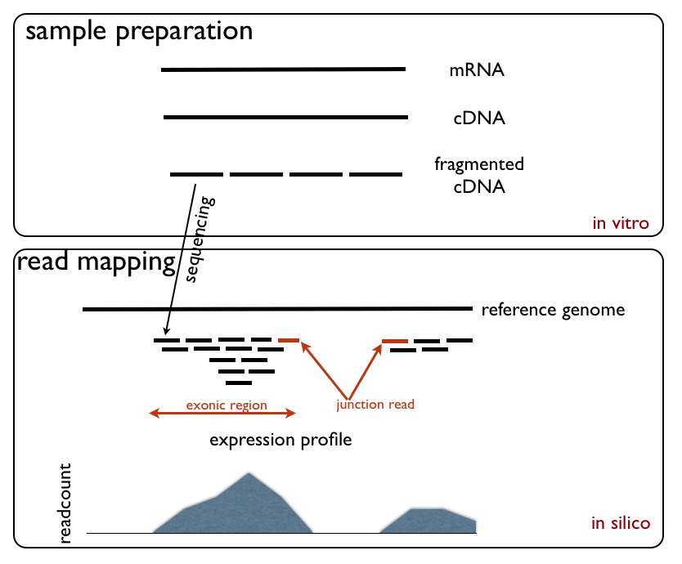
RNA-Sequencing steps
https://upload.wikimedia.org/wikipedia/commons/d/db/RNA_Seq_Experiment.png

Slide 34
RNA-Sequencing steps
https://upload.wikimedia.org/wikipedia/commons/d/db/RNA_Seq_Experiment.png

Slide 35
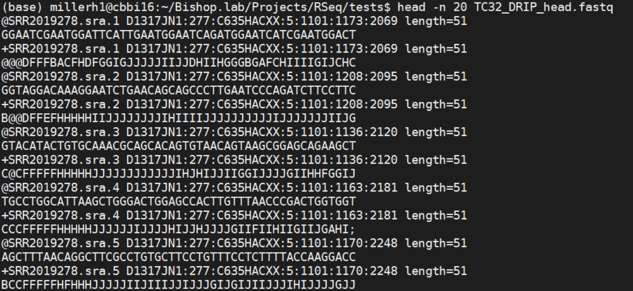
Read 1
Read 2
Read 3

Slide 36
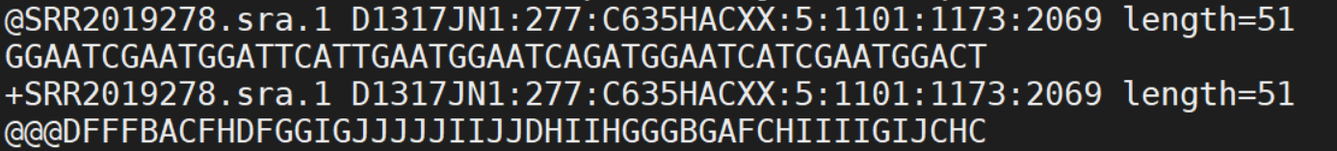
Read ID + sequencing info
GCAT sequence
Placeholder
Quality score of each base

Slide 37
RNA-Sequencing steps
https://upload.wikimedia.org/wikipedia/commons/d/db/RNA_Seq_Experiment.png

Slide 38
RNA-Sequencing steps
https://upload.wikimedia.org/wikipedia/commons/d/db/RNA_Seq_Experiment.png

Slide 39
RNA-seq alignment
RNA-seq typically only looks coding region
Read counts summaried across all exons
Reads over intron/promote regions commonly are NOT coounted
RNA-seq may be extended to cover
Non-coding RNAs (Functional elements)
Small RNAs, etc
5’
3’
TSS
Promoter
Exon
Exon
Coding sequence (CDS)
Intron
Intergenic region

Slide 40
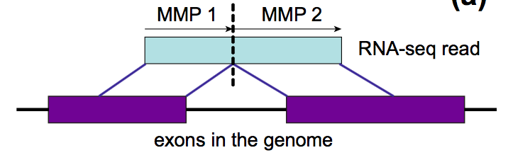
RNA-Seq detects splicing
https://galaxyproject.org/tutorials/rb_rnaseq/

Slide 41
IGV Demo

Slide 42
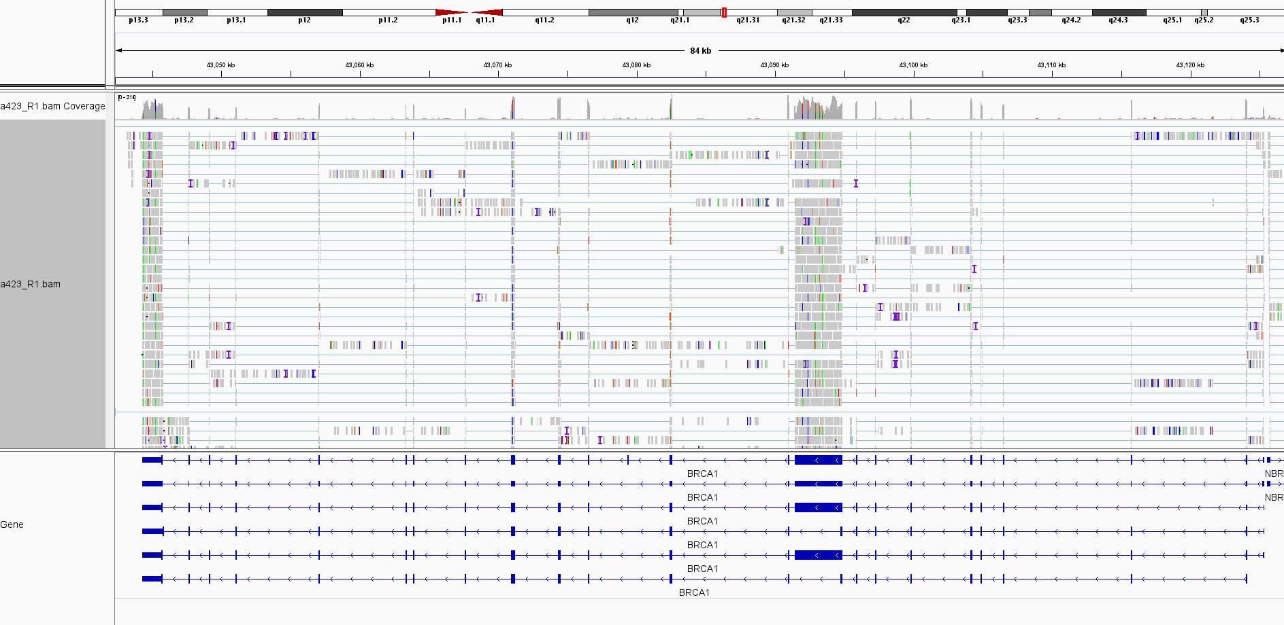

Slide 43
Next step: Quantify!

Slide 44
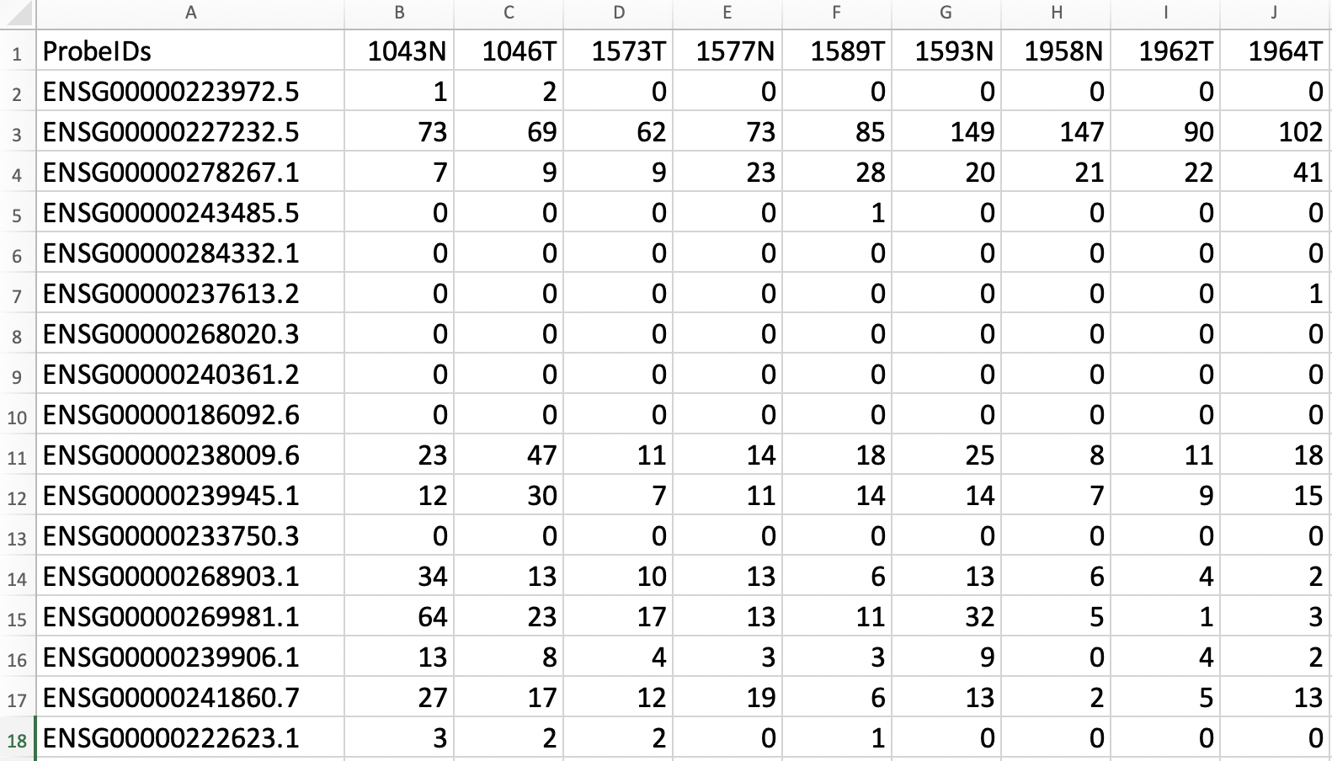
The Gene Count Matrix

Slide 45
The Gene Count Matrix
Gene ID

Slide 46
The Gene Count Matrix
Gene ID
35k + rows

Slide 47
The Gene Count Matrix
Gene ID
Sample name
35k + rows

Slide 48
The Gene Count Matrix
Gene ID
# of sequence reads aligned to this gene
Sample name
35k + rows

Slide 49
The Gene Count Matrix
Alzheimer’s Disease
Healthy Controls

Slide 50
The Gene Count Matrix
Alzheimer’s Disease
Healthy Controls

Slide 51
The Gene Count Matrix
Alzheimer’s Disease
Healthy Controls
Differentially expressed genes?

Slide 52
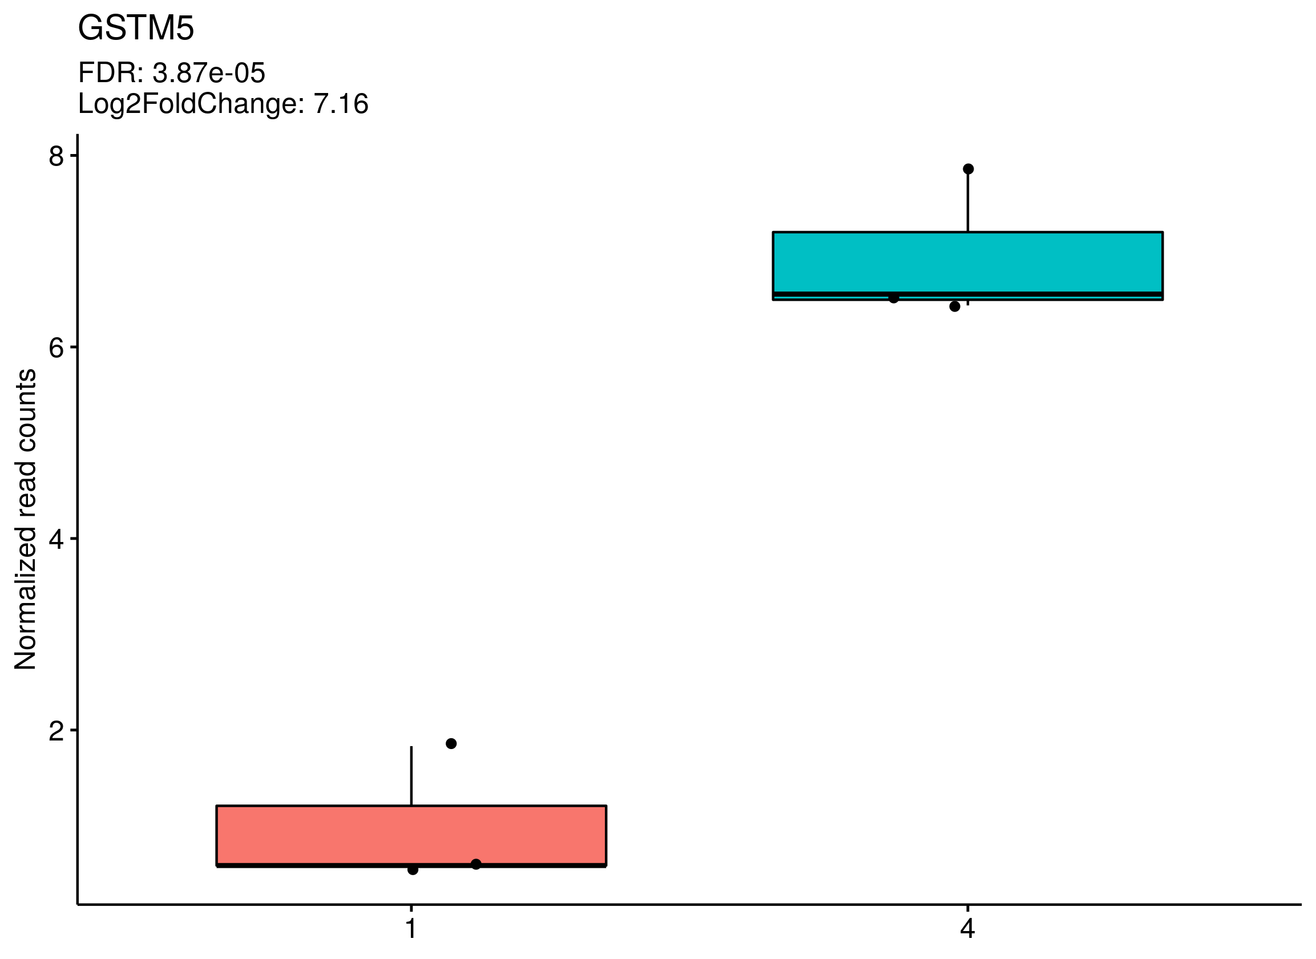
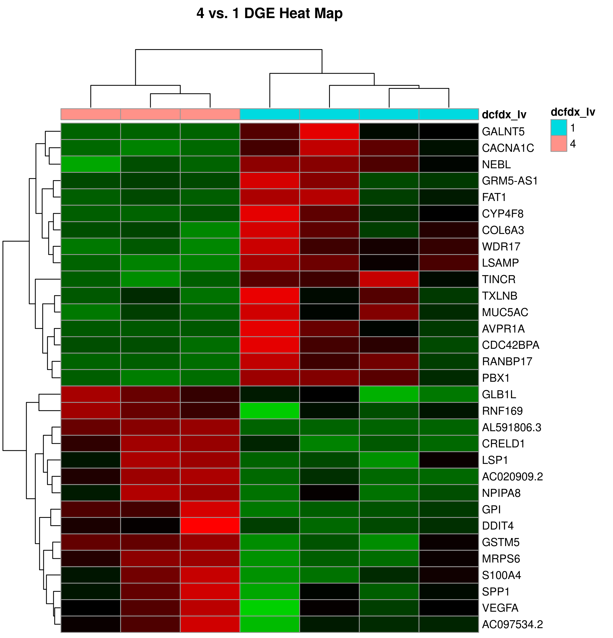
RNA-Seq can detect changes between samples
AD
NCI
NCI
AD

Slide 53
RNA-Seq can detect changes between samples
Questions we can answer:
Pathways overexpressed?
Biological processes overexpressed?
New drug targets?
Gene expression patterns associated with survival?
Gene expression patterns associated with genotypes?
AD
NCI
NCI
AD

Slide 54
RNA-Seq can detect changes between samples
Questions we can answer:
Pathways overexpressed?
Biological processes overexpressed?
New drug targets?
Gene expression patterns associated with survival?
Gene expression patterns associated with genotypes?
Questions we cannot answer:
How do cellular populations change in AD vs NCI?
Do all cell types show the same differential expression?
Are there cell subpopulations which are capable of surviving? Are there vulnerable subpopulations?
AD
NCI
NCI
AD

Slide 55
RNA sequencing cannot resolve heterogeneity within complex samples
Sorted patient cells
Post-mortem tissues
Transfected cells
Clonal cell populations
Organoids
Tumor biopsies
Cell lines
Homogenous
Heterogenous
Suitability for bulk RNA-Seq

Slide 56
Single-cell RNA Seq: every cell is a unique sample
https://community.10xgenomics.com/t5/10x-Blog/Single-Cell-RNA-Seq-An-Introductory-Overview-and-Tools-for/ba-p/547

Slide 57
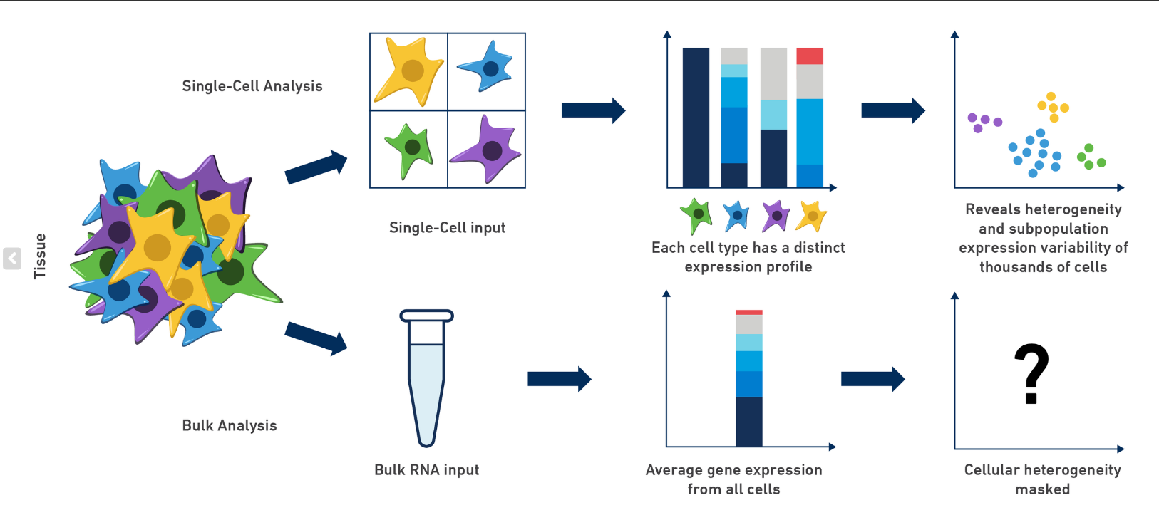
Single-cell RNA Seq: every cell is a unique sample
https://community.10xgenomics.com/t5/10x-Blog/Single-Cell-RNA-Seq-An-Introductory-Overview-and-Tools-for/ba-p/547

Slide 58
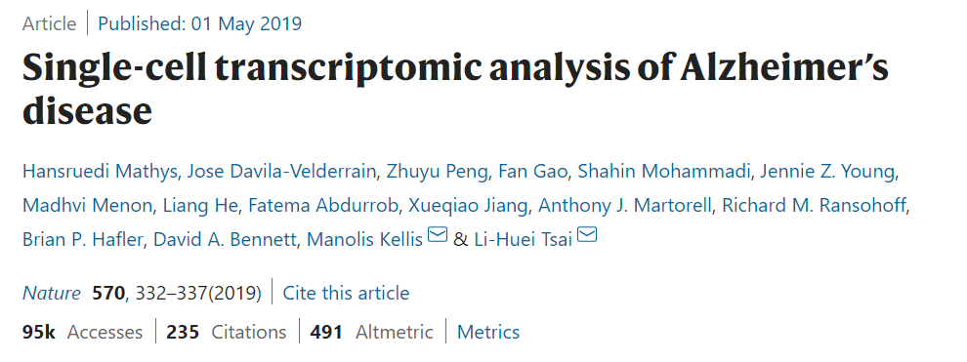

Slide 59
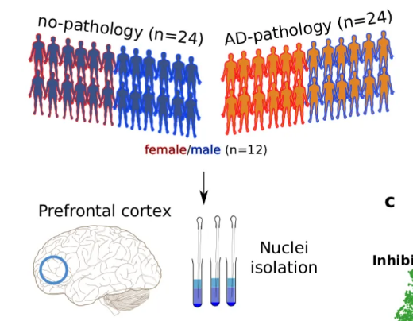
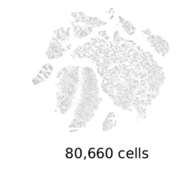
Single-cell RNA-Seq of AD brains

Slide 60
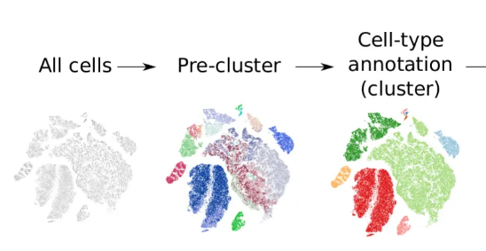
Cells with similar genome-wide mRNA expression will cluster together

Slide 61
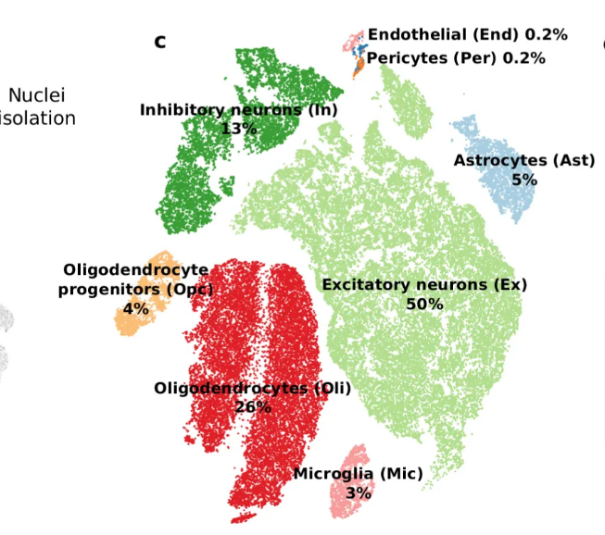
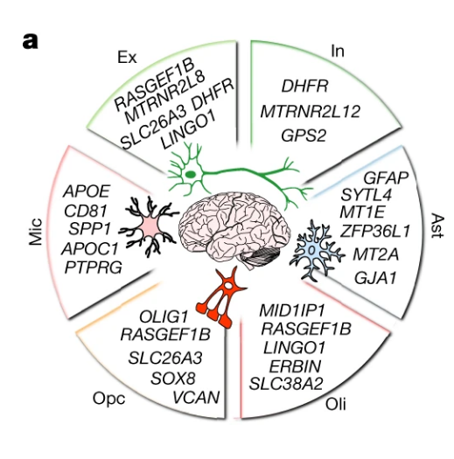
Cell-identity expression markers identify clusters

Slide 62
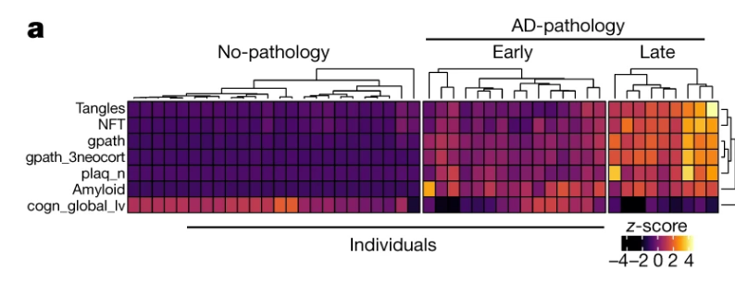
Continuous clinical co-variates

Slide 63
Analysis of DEGs by AD stage

Slide 64
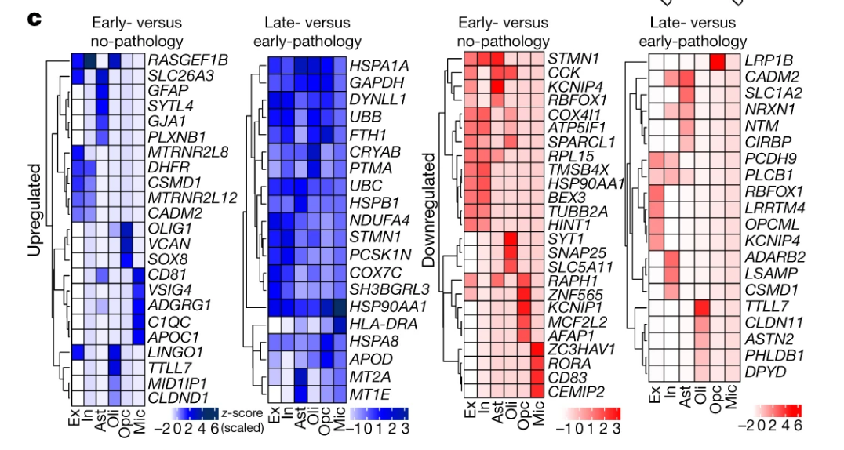
Analysis of DEGs by AD stage

Slide 65
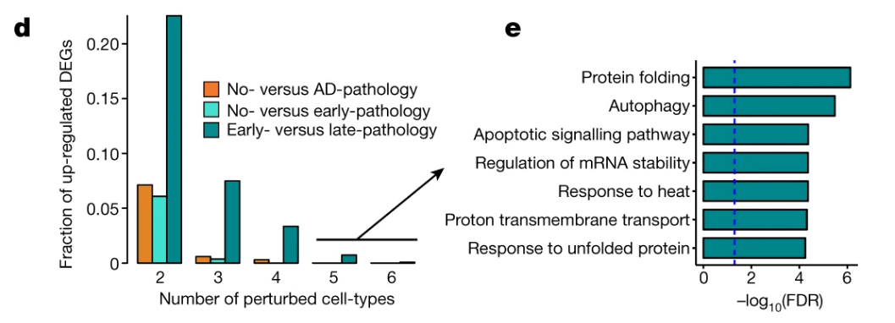
Analysis of DEGs by AD stage

Slide 66
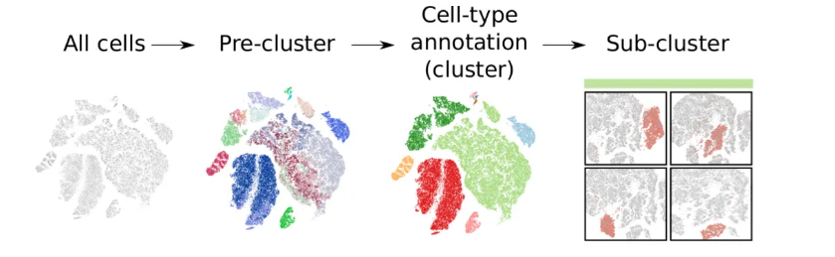
Sub-clustering predicts smaller cell groups within a broader cell type

Slide 67
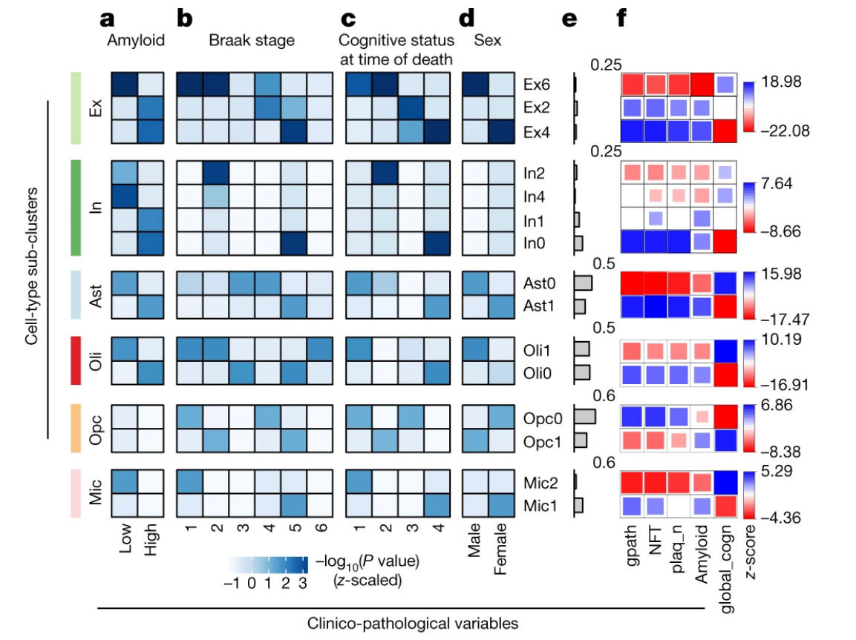
Sub-clusters form based on the disease status and sex of patients

Slide 68
Sub-clusters form based on the disease status and sex of patients

Slide 69
Sub-clusters form based on the disease status and sex of patients

Slide 70
Sub-clusters form based on the disease status and sex of patients

Slide 71
Sub-clusters form based on the disease status and sex of patients

Slide 72
Sub-clusters form based on the disease status and sex of patients

Slide 73
Sub-clusters form based on the disease status and sex of patients

Slide 74
Sub-clusters form based on the disease status and sex of patients

Slide 75
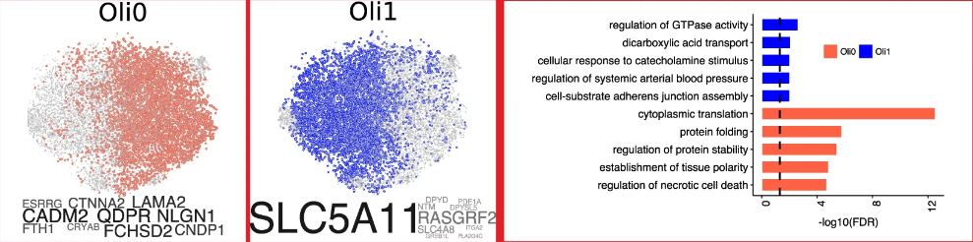
Sub-clusters many AD cells show differences in gene expression
High AD population
Low AD population

Slide 76
Sub-clusters many AD cells show differences in gene expression
High AD population
Low AD population

Slide 77
Sub-clusters many AD cells show differences in gene expression
High AD population
Low AD population

Slide 78
Predicted oligodendrocyte AD sub-cluster confirmed by IHC

Slide 79
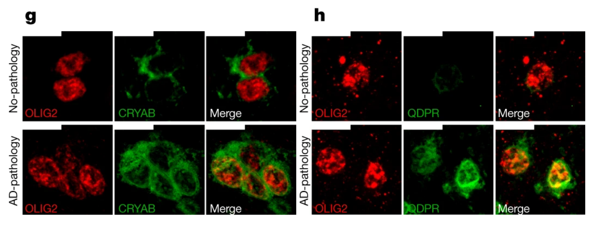
Predicted oligodendrocyte AD sub-cluster confirmed by IHC

Slide 81
Getting into Nature with basically just bioinformatics

Slide 82
https://satijalab.org/seurat/articles/
Miller, H.E.; Gorthi, A.; Bassani, N.; Lawrence, L.A.; Iskra, B.S.; Bishop, A.J.R. Reconstruction of Ewing Sarcoma Developmental Context from Mass-Scale Transcriptomics Reveals Characteristics of EWSR1-FLI1 Permissibility. Cancers 2020, 12, 948. https://doi.org/10.3390/cancers12040948

Slide 83
The Single Cell Workflow

Slide 84
scRNA-Seq Downstream Analysis Workflow
Load Data
QC
Normalize & Scale
PCA & Nearest Neighbor Graph
Clustering
Advanced:
Cluster Marker Analysis
Cell Type Identification
Sub-clustering
Trajectories
Cell Cycle Analysis
Cluster DGE
Low Dimensional Embedding

Slide 85

scRNA-Seq Downstream Analysis Workflow
Load Data
QC
Normalize & Scale
PCA & Nearest Neighbor Graph
Clustering
Advanced:
Cluster Marker Analysis
Cell Type Identification
Sub-clustering
Trajectories
Cell Cycle Analysis
Cluster DGE
Low Dimensional Embedding

Slide 86

scRNA-Seq Downstream Analysis Workflow
Load Data
QC
Normalize & Scale
PCA & Nearest Neighbor Graph
Clustering
Advanced:
Cluster Marker Analysis
Cell Type Identification
Sub-clustering
Trajectories
Cell Cycle Analysis
Cluster DGE
Low Dimensional Embedding

Slide 87
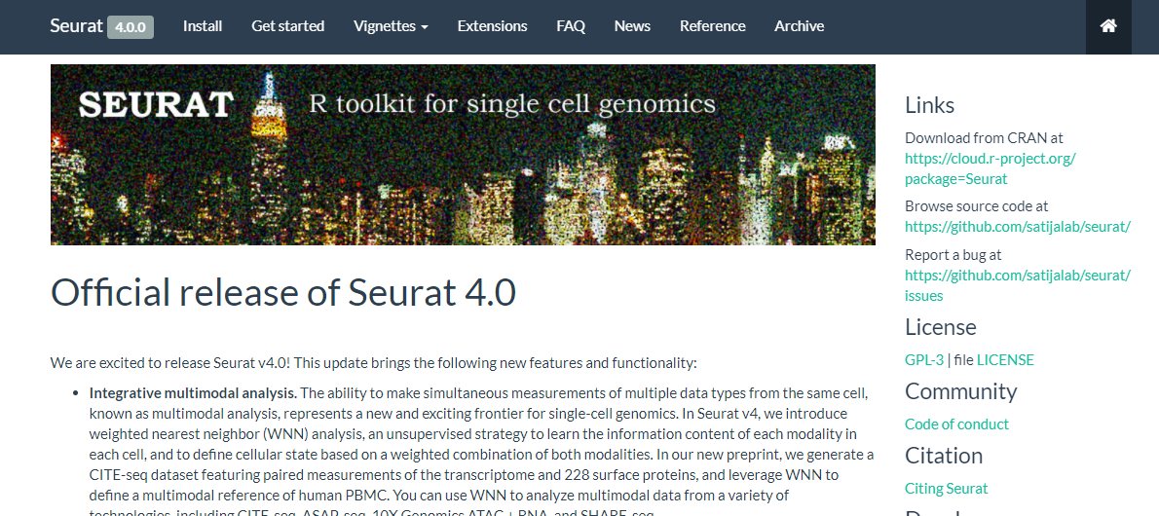

Slide 88
scRNA-Seq Downstream Analysis Workflow
Load Data
QC
Normalize & Scale
PCA & Nearest Neighbor Graph
Clustering
Advanced:
Cluster Marker Analysis
Cell Type Identification
Sub-clustering
Trajectories
Cell Cycle Analysis
Cluster DGE
Low Dimensional Embedding

Slide 89
scRNA-Seq Downstream Analysis Workflow
Load Data
QC
Normalize & Scale
PCA & Nearest Neighbor Graph
Clustering
Advanced:
Cluster Marker Analysis
Cell Type Identification
Sub-clustering
Trajectories
Cell Cycle Analysis
Cluster DGE
Low Dimensional Embedding
You have been provided….
The count matrices from Cell Ranger
A script for loading the data

Slide 90
scRNA-Seq Downstream Analysis Workflow
Load Data
QC
Normalize & Scale
PCA & Nearest Neighbor Graph
Clustering
Advanced:
Cluster Marker Analysis
Cell Type Identification
Sub-clustering
Trajectories
Cell Cycle Analysis
Cluster DGE
Low Dimensional Embedding
You have been provided….
The count matrices from Cell Ranger
A script for loading the data

Slide 91
scRNA-Seq Downstream Analysis Workflow
Load Data
QC
Normalize & Scale
PCA & Nearest Neighbor Graph
Clustering
Advanced:
Cluster Marker Analysis
Cell Type Identification
Sub-clustering
Trajectories
Cell Cycle Analysis
Cluster DGE
Low Dimensional Embedding
You have been provided….
The count matrices from Cell Ranger
A script for loading the data

Slide 92
Seurat getting started demo:
Clone the repo for this workshop:
git clone https://github.com/bigbioinformatics/single_cell_rna_seq_workshop.git

Slide 93
Seurat getting started demo:
Open the .Rproj file for Module #1 in RStudio

